Slide 1
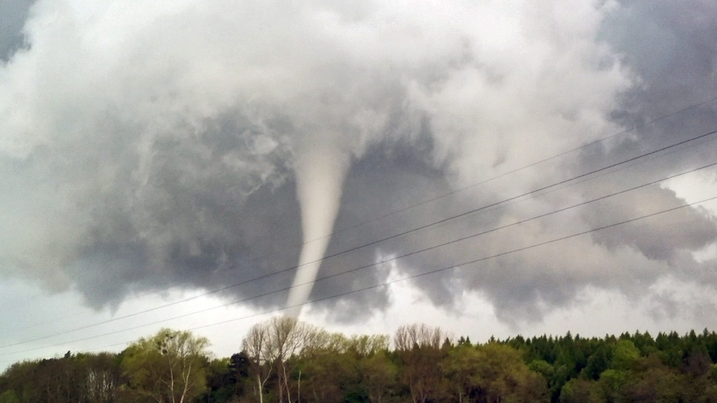
Presentation in English on "Tornado"
Student 7 “Z" class SEI school № 1324 of Moscow
Olesya Solovyova

Slide 2
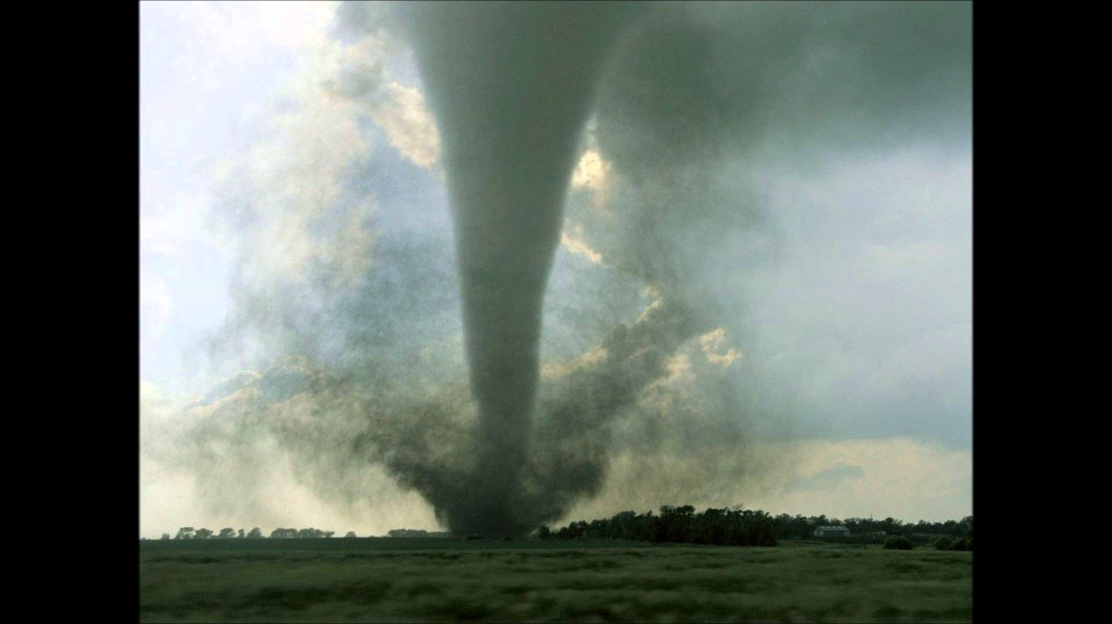
There are many dangerous natural disasters in the world and tornado is one of them. It is defined as a whirling column of air or a funnel – shaped wind.

Slide 3
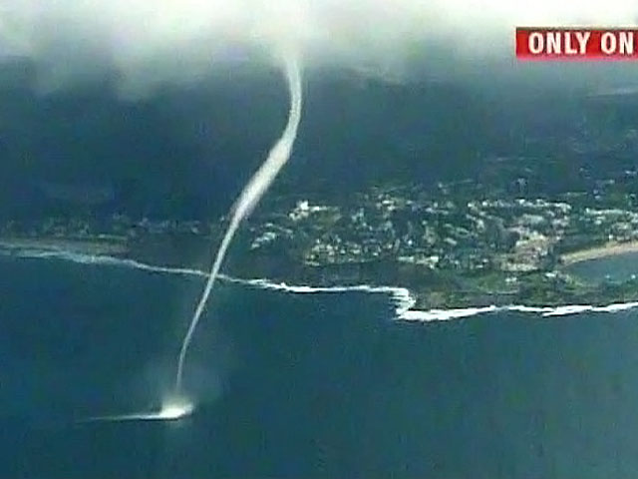
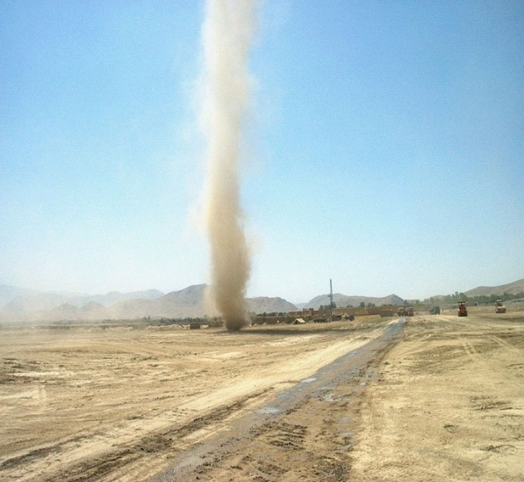
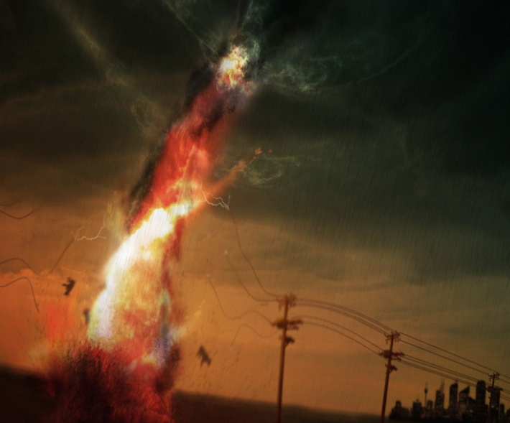
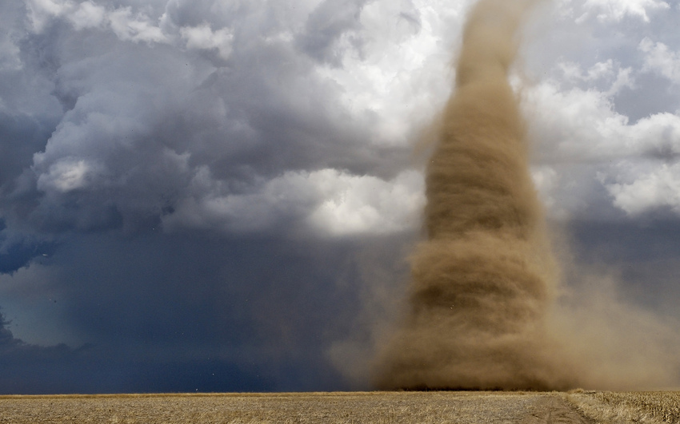
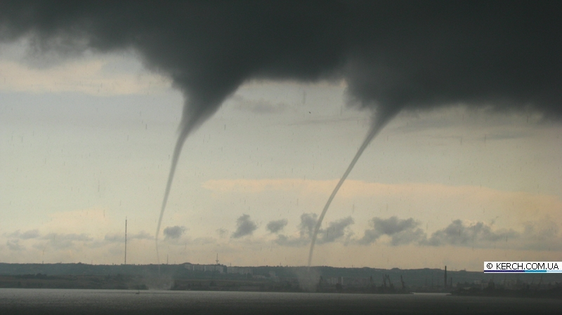
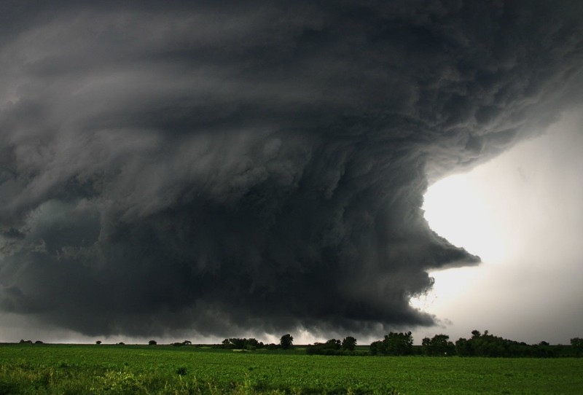
The meteorologists distinguish the following common types of tornado: waterspouts, landspouts, dust devils, steam devils, gustnados, fire whirls.

Slide 4
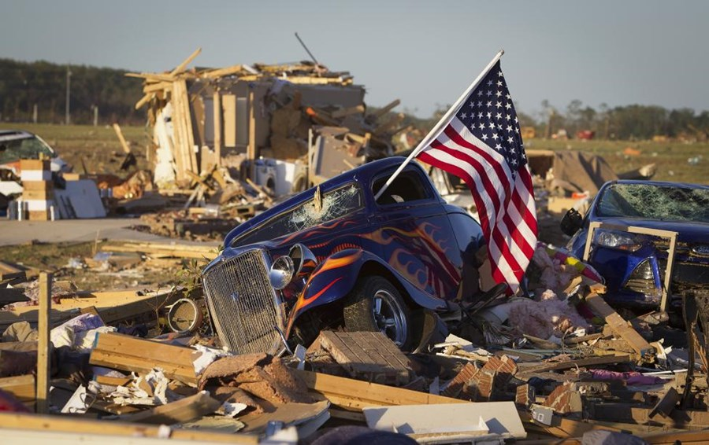
Tornadoes can occur worldwide, but are often reported in the USA.

Slide 5
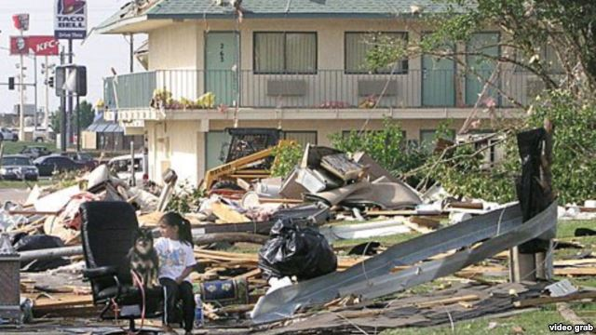
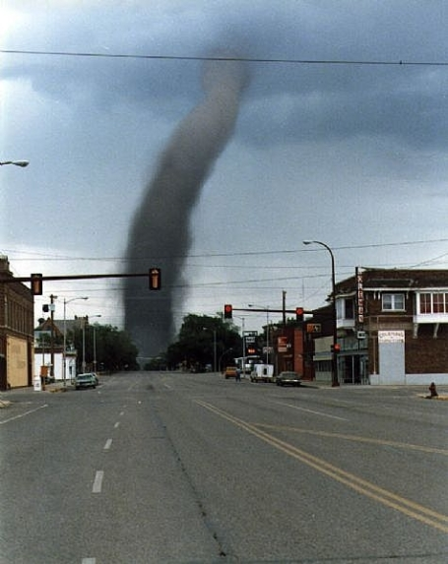
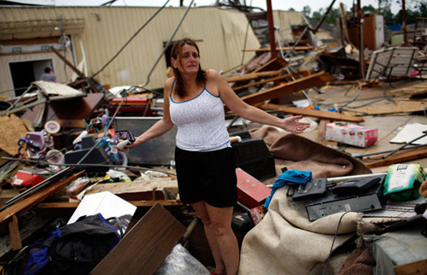
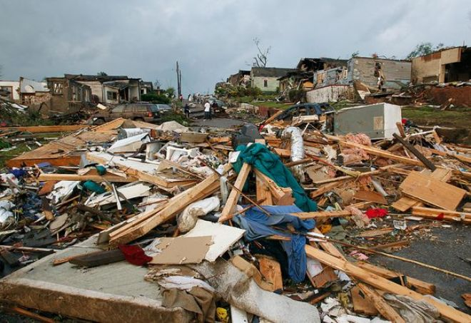
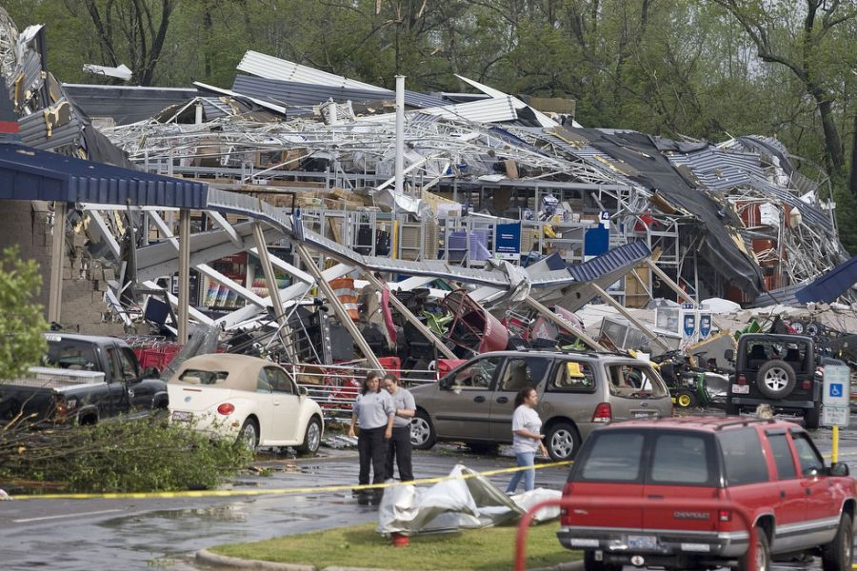
The record-breaking tornado by its damage and duration occurred in spring of 1925, in three states of the USA: Missouri, Illinois and Indiana. This disaster killed more than 600 people, while over 2000 were injured.

