Slide 1
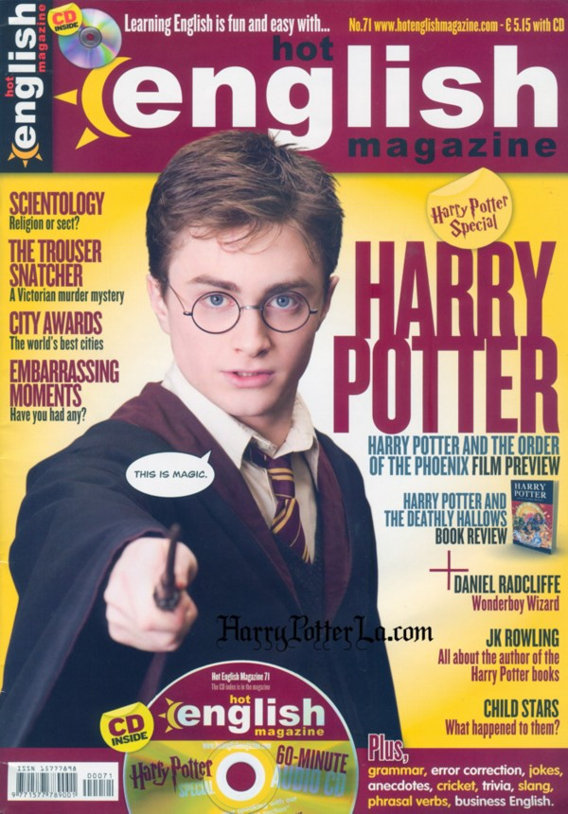
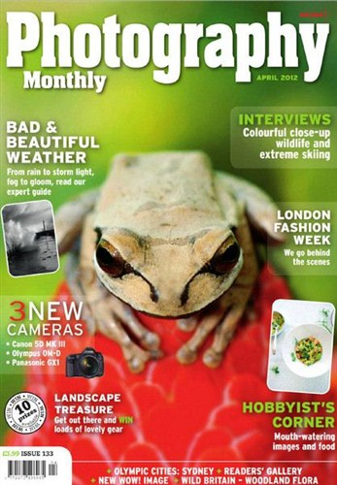

Types of Newspapers in Great Britain

Slide 2
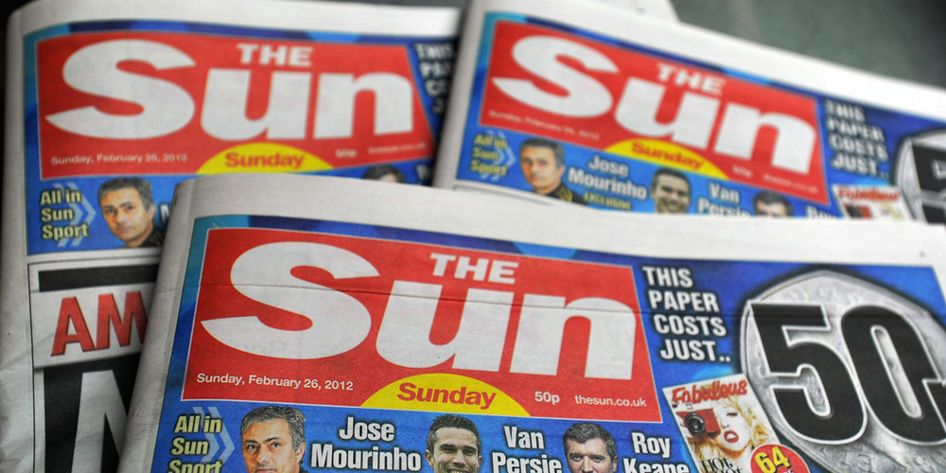
The most popular newspapers in Great Britain are:
News of the World
The Sun
Daily Mail
Mirror
The Lancet
Nature

Slide 3

“News of the world”
The newspaper has a large circulation – about 4,4 millions copies.

Slide 4
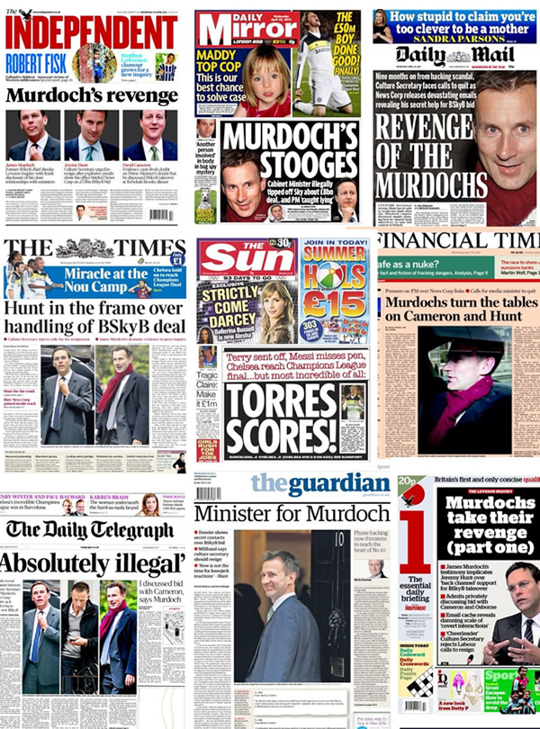
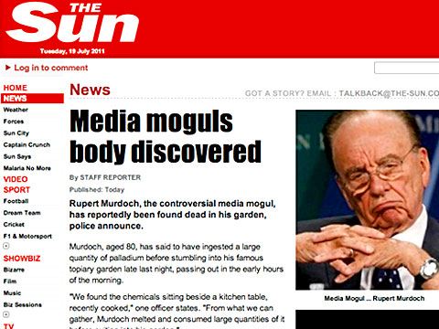
“the Sun” – daily newspaper
It’s circulation is more than 4 millions copies.

Slide 5

“Daily mail”
It’s circulation is more than 2 millions copies.

Slide 6

“Mirror – daily newspaper”
It’s circulation is more than 2 millions copies.

Slide 7
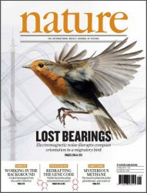
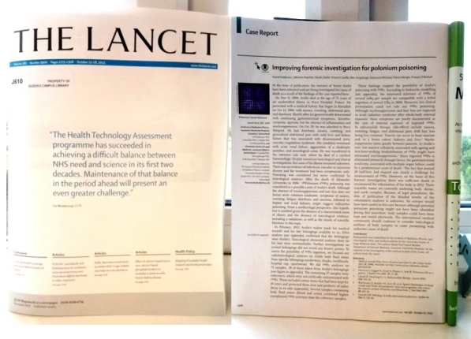
There are a lot of newspapers devoted to art and cultural life in England.

Slide 8
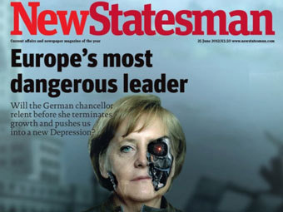
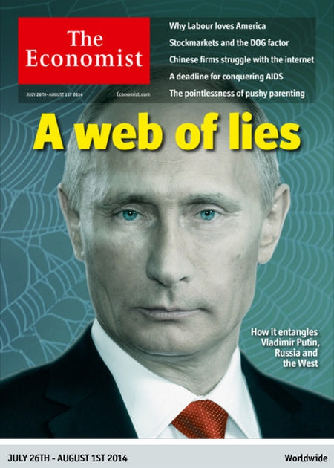
Political and economic magazines of England

Slide 9
Types of newspapers in Britain:
Daily newspapers
National newspapers
Quality papers(The Times, Daily Telegraph, The Guardian, Financial Times, The Independent)
Tabloids
Sundays newspapers(Observer, Sunday Times, Sunday Telegraph, News of the World, Sunday Express, Sunday Mirror, Mail on Sunday)
Local newspapers
Popular newspapers (Daily Express, Daily mail, Daily Mirror, Daily Star, The Sun)

Slide 10
Thank you for your attention!

